Slide 1

CBS Chatbot
Jan, Askin, Niels, Seyma, Timo

Slide 2
Table of contents
Previous Week
Upcoming Week
Findings

Slide 3
Previous week
Literature study
01
Various models
CBS
02
Discussed our progress
Received more data
Worked on online courses
5 models
3 types of TF-IDF
Plotted accuracy and learning rate of Naïve Bayes model
Jeroen
03
Visualizing data
04
Feedback
Meeting

Slide 4
Machine learning models
Current Models
Extreme Gradient Boosting
Linear Regression
Naïve Bayes
Random Forest
New Models
Recurrent Neural Networks - Long Short Term Memory
Convolutional Neural Network

Slide 5
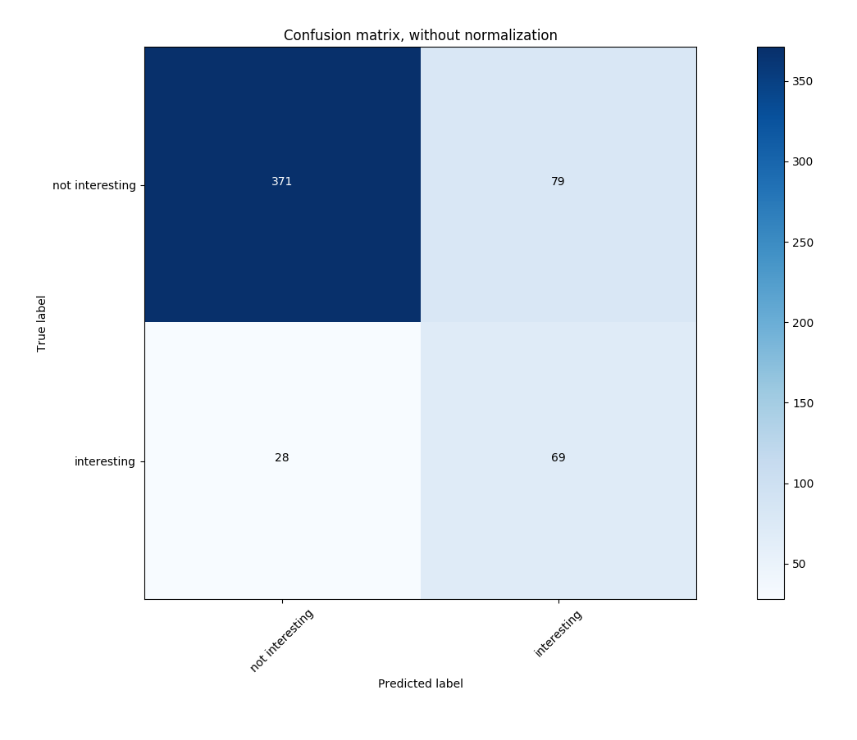
Findings of Visualizing Data
450 sentences
80%
20%
100
sentences
30%
70%
Naïve Bayes Accuracy

Slide 6
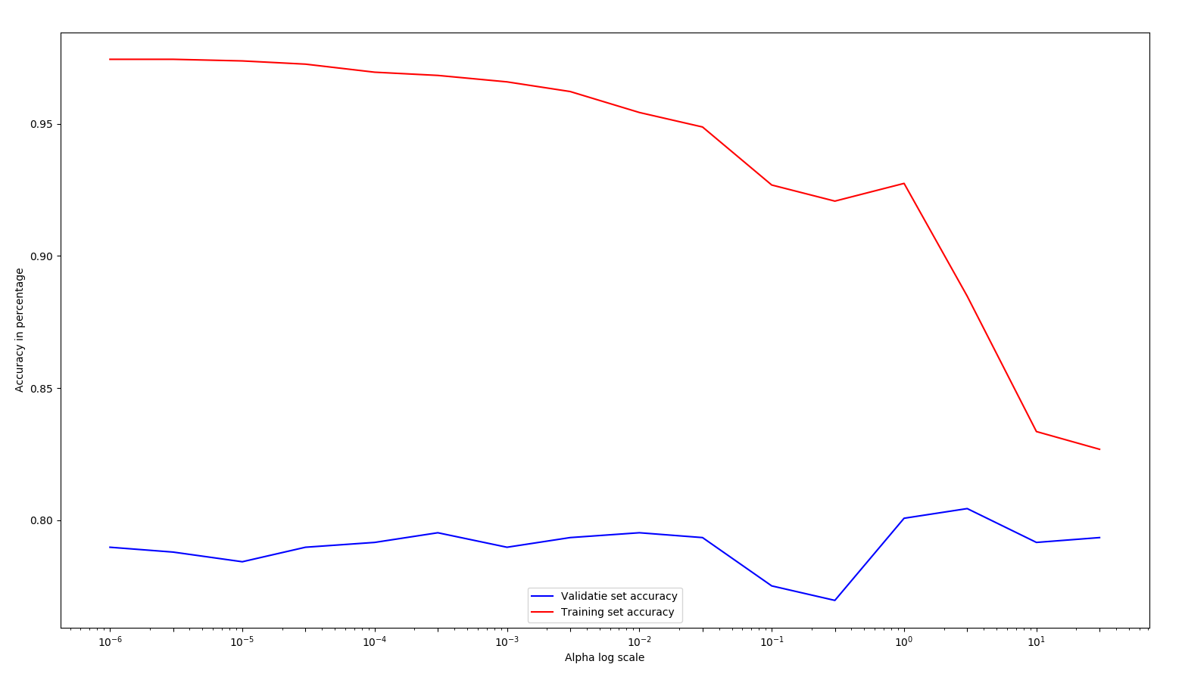
Findings of Visualizing Data
Naïve Bayes Accuracy
Notes:
Things to say:
Finding visualizing data
Accuracy y lijn
Alpha log scale x lijn
Blue line is validation
Red line is training set
Percentage dataset is by default door functie bepaald, dus 0.25 procent van dataset is gebruikt voor validatie
Te hoge variance waardoor we meer testdata nodig hebben.
Tot hier (aanwijzen) is de accuracy stabiel en hier in een dip. Dit komt waarschijnlijk door
Overfit/underfit formatten.

Slide 7
Upcoming Python projects
Wikipedia
01
Testing and evaluation
Visualizing Data
03
Comparing all models
Models
02
Extra data to create a baseline for our model

Slide 8
Upcoming week
Finishing Research plan
01
Subquestion 1
Visualizing Data
03
Subquestion 2
Literature study
02
Online courses
Receiving and process feedback
Language models
Plotting the accuracy and learning rate (best type model)

Slide 9

Questions?

